Slide 1

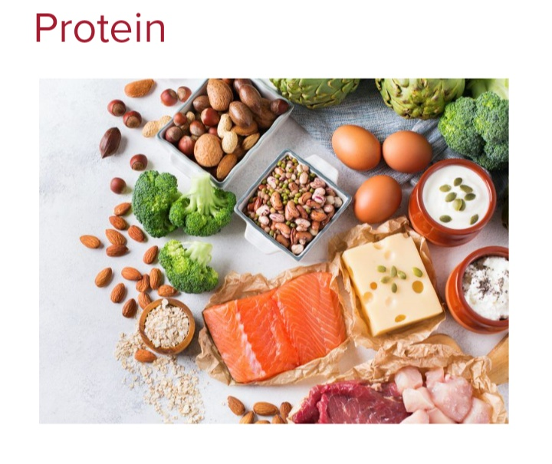
Biology for Engineers
Proteins
Introduction:
Protein is a nutrient our body needs to grow and repair cells, and to work properly.
Protein is found in a wide range of food and it’s important that we get enough protein in your diet every day.
Weight of a person, gender, age and health determines the quantity of protein required.

Slide 2
Biology for Engineers
Proteins
Proteins are made up of amino acids which are called building blocks.
20 different amino acids that link together in different combinations.
Our body uses them to make new proteins, such as muscle and bone, and other compounds such as enzymes and hormones.
It can also use them as an energy source.

Slide 3
Biology for Engineers
Proteins
Protein as food
Two types of amino acids in food – 1) essential amino acids (those which cannot be synthesised in the body) Eg: Histidine, leucine, isoleucine, etc.
2) Non-essential amino acids (those which the body can synthesise) Eg: Arginine, Aspartic acid, Glutamic acid, etc.
Meat, fish, eggs, milk and dairy products are high sources of good quality protein. Pulses (peas, beans and lentils), nuts, seeds, legumes, tofu, textured vegetable protein and tempeh are sources of lesser quality protein.
Despite the lower quality of the protein in these foods, they are an important contribution to the diets of many pregnant women worldwide, in particular those with consuming little or no meat for economic, social, cultural or religious reasons.
The WHO recommend that additional protein should be consumed through dietary sources rather than supplements (WHO/FAO/UNU, 2007).

Slide 4
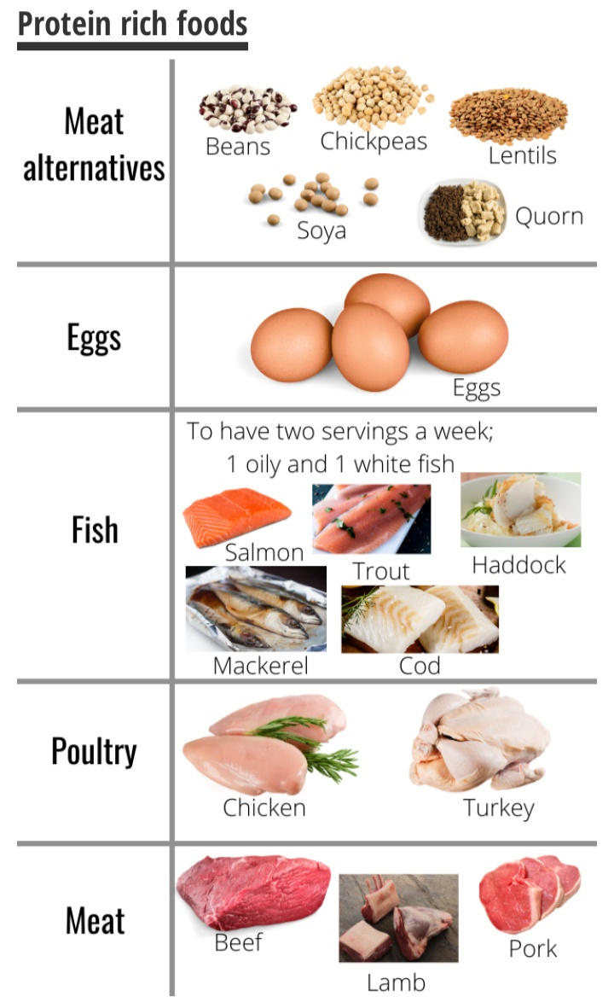
Proteins
Biology for Engineers

Slide 5
Proteins
Biology for Engineers
Multiple protein functionality in selected processed foods
Type of food Multiple functionality
Beverage Solubility, grittiness, color
Baked goods Emulsification, foaming, gelation
Dairy substitutes Gelation, foaming, emulsification
Egg substitutes Foaming, gelation
Meat emulsions Emulsification, foaming, gelation, adhesion-cohesion
Soups and gravies Viscosity, emulsification, water adsorption Topping Foaming, emulsification
Whipped dessert Foaming, gelation, emulsification

Slide 6
Proteins
Biology for Engineers
WHEY PROTEINS
Whey or serum proteins are soluble milk proteins representing about 20% of total milk proteins.
The β-lactoglobulin, α-lactalbumin, proteose peptone, serum albumin, and immunoglobulins form the bovine whey proteins.
They are available as an ingredient in the form of whey powder, whey protein concentrates, and whey protein isolates.
The unique characteristics of whey proteins such as solubility over a wide range of pH, favorable nutritional profile with respect to essential amino acids, diverse functionality, and relatively low cost make them an ideal ingredient in formulating wide array of food products.

Slide 7
Biology for Engineers
Proteins
Whey protein ingredients have become increasingly important in formulated foods over the past 30 years. Whey proteins are usually supplied as whey protein concentrates (80% protein) and whey protein isolates (90% protein).
Whey proteins are a by-product from processing of other dairy products - cheese and casein.

Slide 8
Proteins
Biology for Engineers
MEAT ANALOGS
Meat analog refers to replacement with ingredient other than meat.
It also called a meat substitute, meat alternatives, fake or mock meat, and imitation meat.
Meat Analogs consists of low fat and calorie foods intake,
Currently, available marketed meat analog products are plant-based meat in which the quality (i.e., texture and taste) are similar to the conventional meat.
The ingredients are mainly soy proteins with novel ingredients added, such as mycoprotein and soy leghemoglobin.
However, plant-based meat is sold primarily in Western countries

Slide 9
Biology for Engineers
Proteins
Advance technology - lab-grown meat with no livestock raising, known as cultured meat will be expected to boost the food market in the future.
Meat Analogs are advantageous because they are cost-effective, reliable production, and consistent quality
But product safety is the top priority. Therefore, the regulatory frameworks need to be developed alongside.

Slide 10
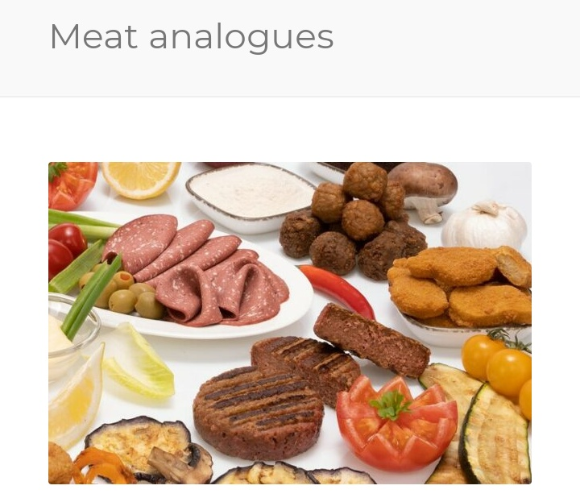
Biology for Engineers
Proteins

Slide 11
Biology for Engineers
Proteins
PLANT BASED PROTEIN
Plant based protein or plant based food refers to plant based products that are direct replacement of animal based protein products.
These products use the biomimicry approach to replicate animal based protein products in terms of texture and flavour.
Plant sources like soy, lentils, jack fruit, seitan, temph, broccoli, quinoa, ragi etc. can be used to make products that can replace animal based meat, egg and sea food.

Slide 12
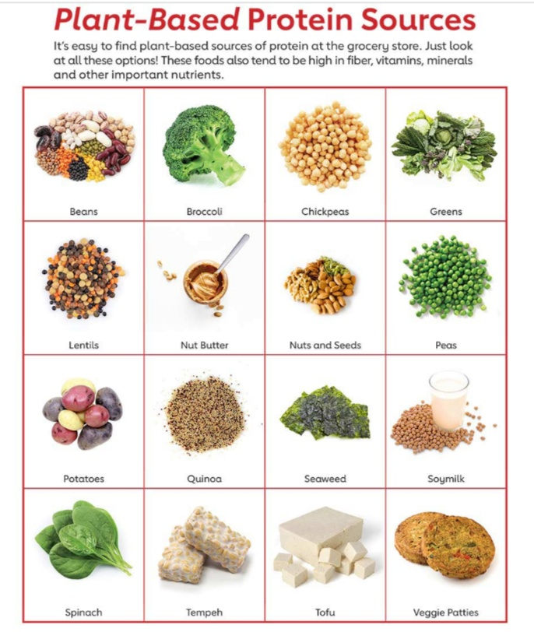
Biology for Engineers
Proteins

Slide 13
Biology for Engineers
Proteins
Plant based meat: uses 72 to 89% less water than conventional meat
Animal agriculture uses almost a third of the water used in global agriculture.
Plant based: meat causes 51% to 81% less aquatic nutrient pollution than conventional meat.
Plant based meat requires no antibiotics. About 70% of medically relevant antibiotics are used in animal agriculture.

Slide 14
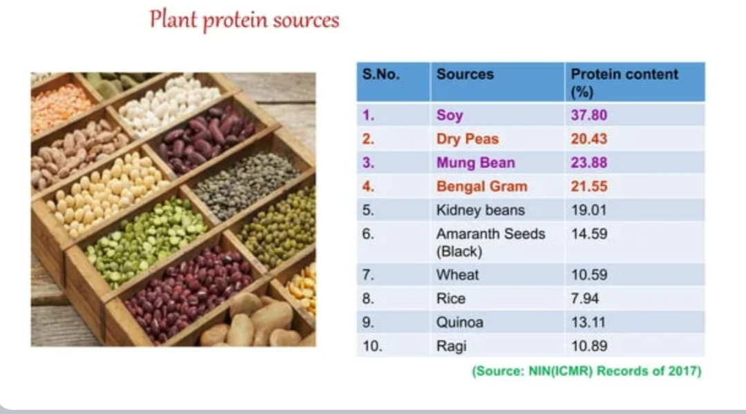
Biology for Engineers
Proteins

